Slide 1





DYNAMIC BELIEF-STATE BASED ANTI-POACHING PATROL PLANNING SYSTEM
EXPLORE. PROTECT. PRESERVE.
Mohamed Ismail Fawaz K P ,
240701324
Mohammed Rizwan Sheik Mansoor, 240701327

Slide 2


ABSTRACT
A Dynamic Belief-State Based Anti-Poaching Patrol Planning System that handles uncertain poacher locations using probabilistic reasoning. It combines historical data, camera observations, and ranger feedback to continuously update the belief state and dynamically adjust patrol routes based on distance and patrol constraints. The system enables adaptive decision-making in a partially observable wildlife environment without using machine learning.

Slide 3

The Problem
Wildlife reserves cannot continuously monitor every area, while poachers actively avoid detection and their exact locations are rarely known. Available information from cameras, ranger observations, historical incidents, and field evidence is often incomplete, noisy, or delayed. Traditional fixed or intuition-based patrols may not adapt effectively to changing situations.
Therefore, there is a need for a system that can maintain a belief about possible poacher locations, continuously incorporate new information, and dynamically plan or replan patrol routes while considering constraints such as patrol distance and the number of patrols available.

Slide 4

Literature Survey
Game-Theoretic and Data-Driven Patrol Planning
PAWS uses security games to generate efficient, randomized patrol schedules (Fang et al., 2016), later adding ML models of poacher behaviour. Xu et al. (2020) used Gaussian processes to quantify prediction uncertainty, raising snare detection by about 30%. Wang et al. (2019) added real-time information such as footprints and used deep reinforcement learning to adapt patrols to it.
Belief-Based Search Under Uncertainty
Bayesian search keeps a belief map that is propagated with a target motion model (prediction) and then refined with sensor observations (update). POMDPs formalise this, with the belief state summarising the full observation history without loss of optimality, but exact POMDP solving is PSPACE-hard, so lightweight belief-based methods are attractive.

Slide 5
Research Gap
  Existing anti-poaching planners rely on ML or deep RL, which needs large, biased and imbalanced historical datasets. Their behaviour is also hard to interpret for rangers.
  Many prescribed patrols are not adaptive. Earlier plans were not adjusted to observations made during the patrol, even though camera-trap and ranger information arrives in real time.
  Bayesian search and POMDP work is largely domain-agnostic (UAV and robot search). It rarely combines historical priors, camera detections and ranger feedback in one belief update, or ties replanning to distance and patrol-length constraints.
  Our contribution: an interpretable, ML-free belief-state framework that fuses these three evidence sources and replans patrol routes under practical constraints.

Slide 6
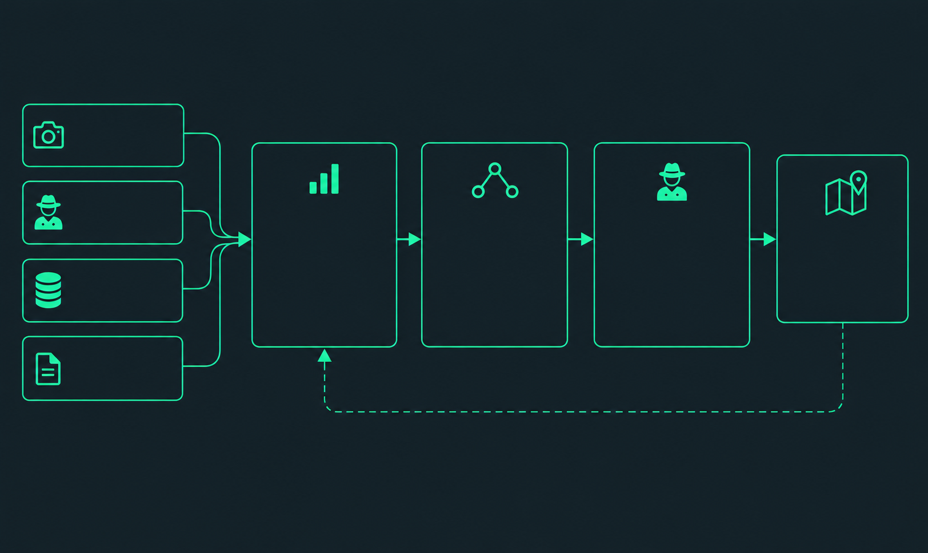

System Architecture
Camera Observations
Ranger
Reports
Belief State
Engine
Patrol
Planner
Patrol
Execution
Patrol Route
  Bayesian Update
  Markov Transition Model
  Probability Distribution
  Dijkstra / A*
  Expected Detection
  Distance Constraints
  Route Execution
  Ranger Feedback
  Dynamic Replanning
  Optimized Route
  Current Position
  Patrol Constraints
Historical
Data
Field Evidence
New Observation
Belief State Update

Slide 7

Expected Outcomes
Accurate Risk Estimation: Identify high-probability poacher zones using available observations and historical data.
Adaptive Patrol Planning: Generate patrol routes that prioritize high-risk areas within defined constraints.
Efficient Resource Utilization: Reduce unnecessary travel while improving coverage of critical zones.
Improved Detection: Increase the likelihood of detecting potential poaching activity through informed patrol decisions.

Slide 8

THANK YOU

